Slide 1
Wrapping a static array
...
Written by Rachel J. Morris, last updated 1/30/17

Slide 2
Topics:
Reviewing static arrays
Pitfalls of static arrays
Making a smarter array

Slide 3
Static arrays...
Arrays come in handy in our programs once we’re storing lots of data of the same type.
We wouldn’t want to have separate variables for each piece of data, because programming how we’d access that data would be tedious.

Slide 4
Static arrays...
Before we get into dynamic arrays in previous classes, we first work with static arrays.
Static arrays…
Must have a defined size at compile-time
Cannot be resized while the program is running
Have the risk of crashing the program if you go out of bounds of the array

Slide 5
Static arrays...
Example program…

Slide 6
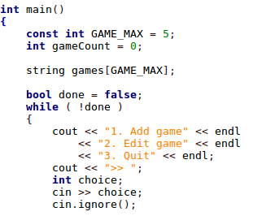
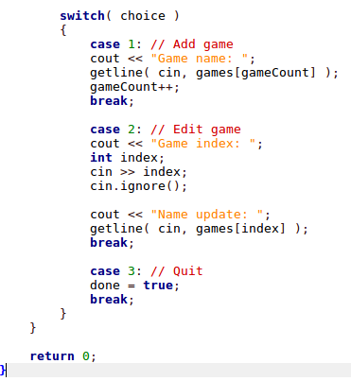
Static arrays...
1
2
We have to keep track of both the array size AND amount of items entered in the array.

Slide 7
Static arrays...
1
2
If we don’t keep track of the # of items added, we could easily go out-of-bounds & crash the program.

Slide 8
Static arrays...
1
2
If we don’t validate the user’s input, they might give an invalid index, causing out-of-bounds access & program crash

Slide 9
Static arrays...
Having to write code to
Keep track of the array size and item count
Validate user input
Check whether the # of items added == array size
Making sure nothing can access an invalid index
Is extra work, and duplicate work, each time you have to implement a structure to store a list of data.

Slide 10
Static arrays...
Why not use classes to write a “smart array” that handles this for us ONCE, so we can just keep reusing that smart array over and over?

Slide 11
Static arrays...
Why not use classes to write a “smart array” that handles this for us ONCE, so we can just keep reusing that smart array over and over?
Now we’re starting to think about data structures

Slide 12
Smart array (static)
Let’s implement a smart array (using just a static array for now).

Slide 13
Additional functionality
Other functions to add to your smart array:
Insert (at index, not just at the end)
Extend (put one array at the end of another)
Remove (at index)
Operator overloading: (subscript [ ], =, ==)
Part of the challenge will be figuring out how this functionality should be implemented yourself.

Slide 14
Additional functionality
How to insert “Z” at position 2?
And how to test?
0
A
1
C
2
E
3
G
4
I
5
Index
Value
0
A
1
C
2
Z
3
E
4
G
5
I
Index
Value

